Slide 1
B39HF High Frequency Circuits
Chapter 2 Transmission Lines
Yongqiang Hei
yqhei@mail.xidian.edu.cn

Slide 2
Chapter 2 Outline
Transmission lines
General Consideration
Lumped-Element Model
Transmission Lines Equations
Wave Propagation of Transmission Lines
Lossless Transmission lines
General Consideration
Wave Impedance of the Lossless Line
Special Cases of the Lossless Line
Power Flow on a Lossless Transmission Line

Slide 3
Chapter 2 Outline
Transmission lines
General Consideration
Lumped-Element Model
Transmission Lines Equations
Wave Propagation of Transmission Lines

Slide 4
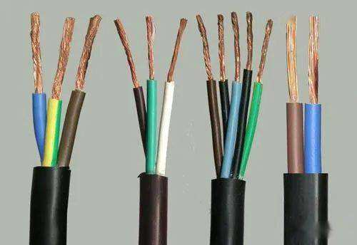
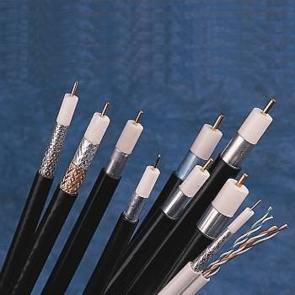
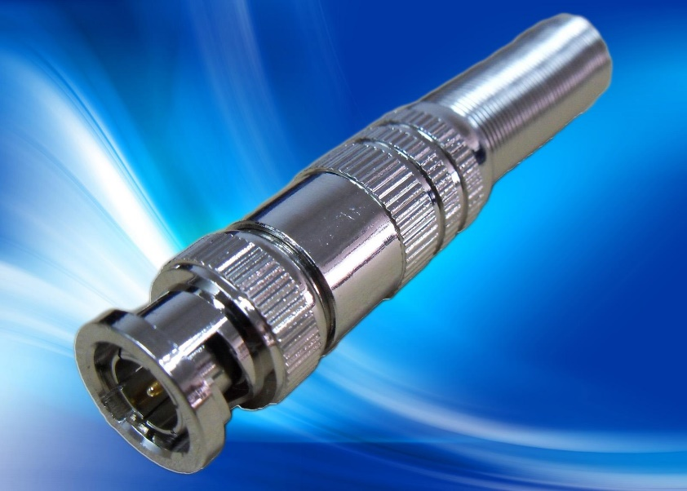
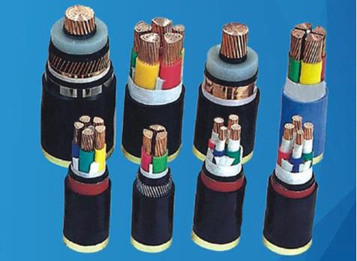
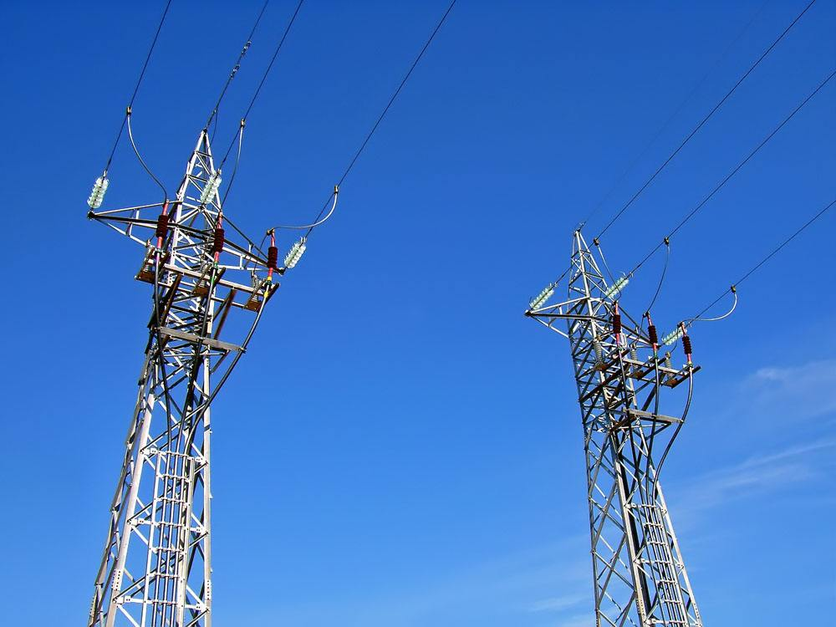
Transmission Line Motivation

Slide 5


Transmission Line Motivation
When the length of the line is much smaller than the wavelength, the effects caused by the line in the electric/magnetic fields is negligible.
Circuit theory can be applied (KCL, KVL,…)

Slide 6
Transmission Line Motivation
Why Transmission Line Theory ？

Slide 7
Transmission Line Motivation
Circuit Theory: theory of lumped elements (R, C, L), conducting wires play no role (space-independent v, i), simple, approximate.
EM Theory : A full vector analysis based on Maxwell’s equations, is most complete, accurate, however, too complex .
Transmission line Theory : bridge circuit theory and EM theory, theory of distributed circuits, using the EM theory to derive the distributed parameters, dealing with them by using circuit theory.

Slide 8
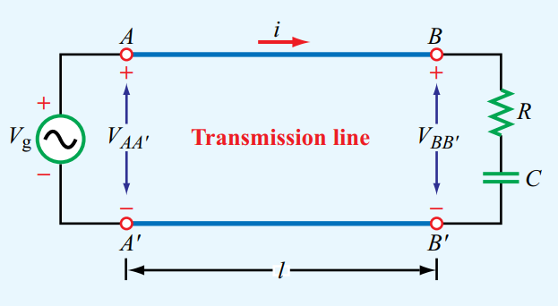
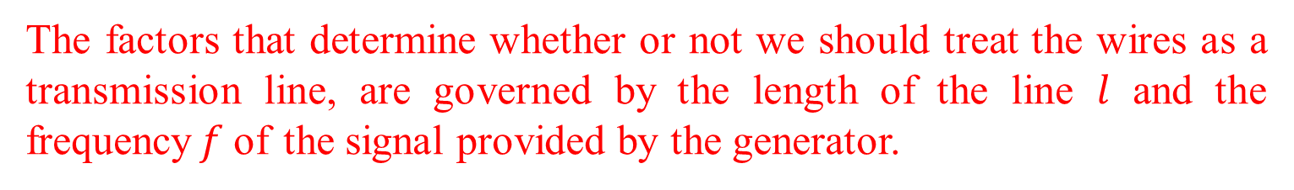
The Role of Wavelength
A simple circuit, elements usually are interconnected using a pair of wires. Generator is connected to a RC load via a pair of wires.
Is the pair of wires between AA’ and BB’ a transmission line?
The factors that determine whether or not we should treat the wires as a transmission line, are governed by the length of the line $l$ and the frequency$f$of the signal provided by the generator.

Slide 9
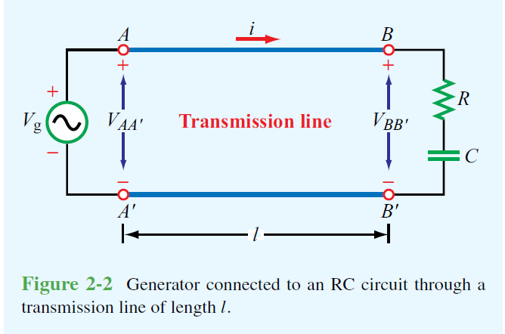
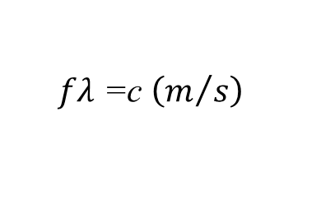
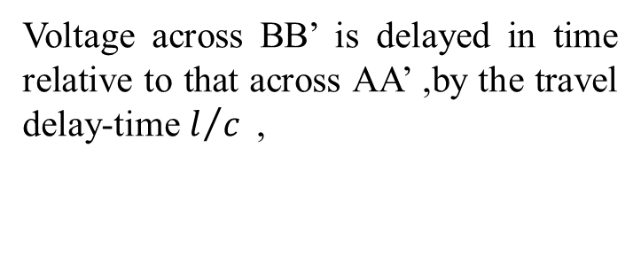
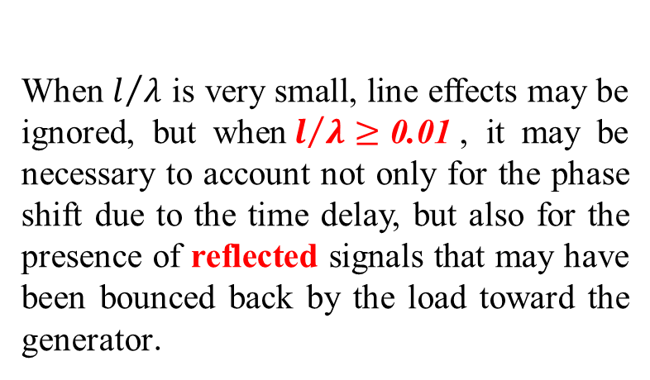
The Role of Wavelength
Voltage across BB’ is delayed in time relative to that across AA’ ,by the travel delay-time $l/c$,
Where
$\text{When}$ $l/λ$ is very small, line effects may be ignored, but when${ l}/λ≥\text{0.01}$, it may be necessary to account not only for the phase shift due to the time delay, but also for the presence of reflected signals that may have been bounced back by the load toward the generator.
Due to
$$fλ \text{=}\text{c} \left(m/s\right)$$
Hence,

Slide 10
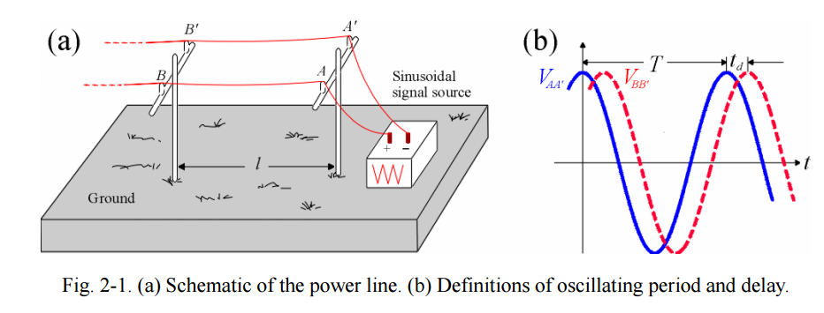
The Role of Wavelength
Voltage across BB’ is delayed in time relative to that across AA’ ,by the travel delay-time $l/c$,

Slide 11
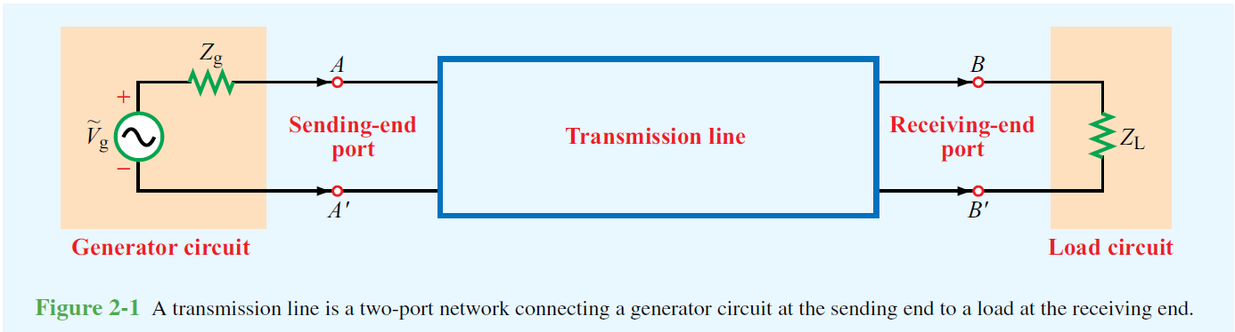
Transmission Line Modeling
Transmission lines (TLs) use two-port circuit theory for representation, the operating wavelength is proportional to the circuit size.
By modelling TLs in the form of equivalent circuits at high frequencies (HFs), Kirchhoff’s voltage and current laws to develop wave equations.
Allows characterization of standing waves, power transfer, and voltage and current along the TL.

Slide 12
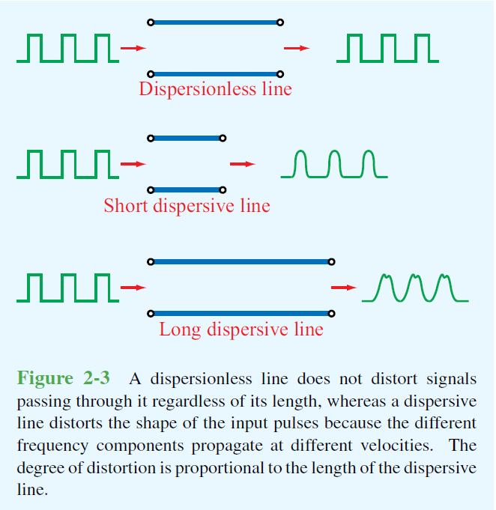
The Role of Wavelength
At HF, since the wavelength compared to the circuit, power loss and dispersion effects have to be considered
TL with dispersion: the wave velocity is not constant as a function of frequency.
The shape of a rectangular pulse is distorted, as it travels down the line
Differ. frequency components not propagate at the same frequency.

Slide 13
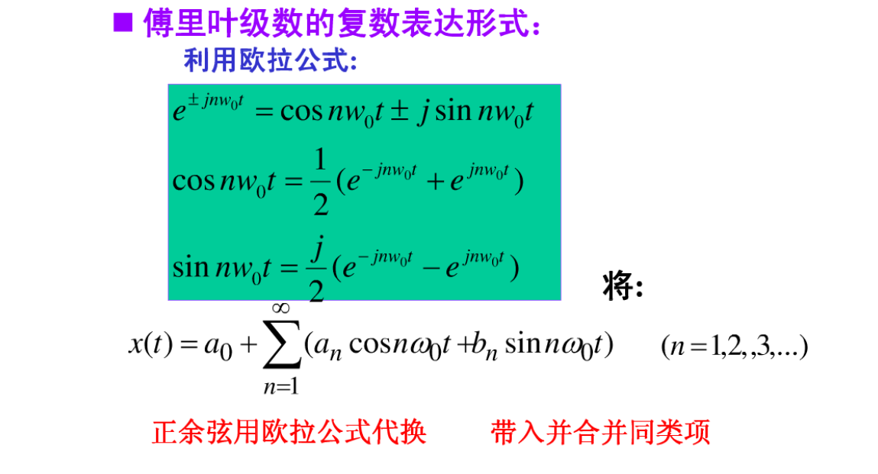

Slide 14
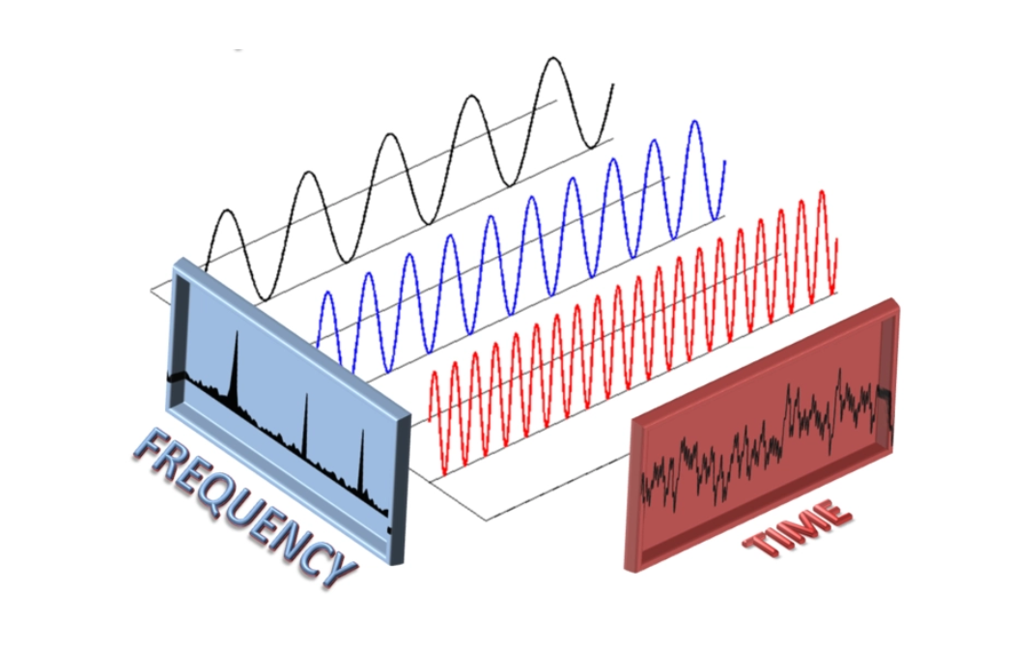

Slide 15
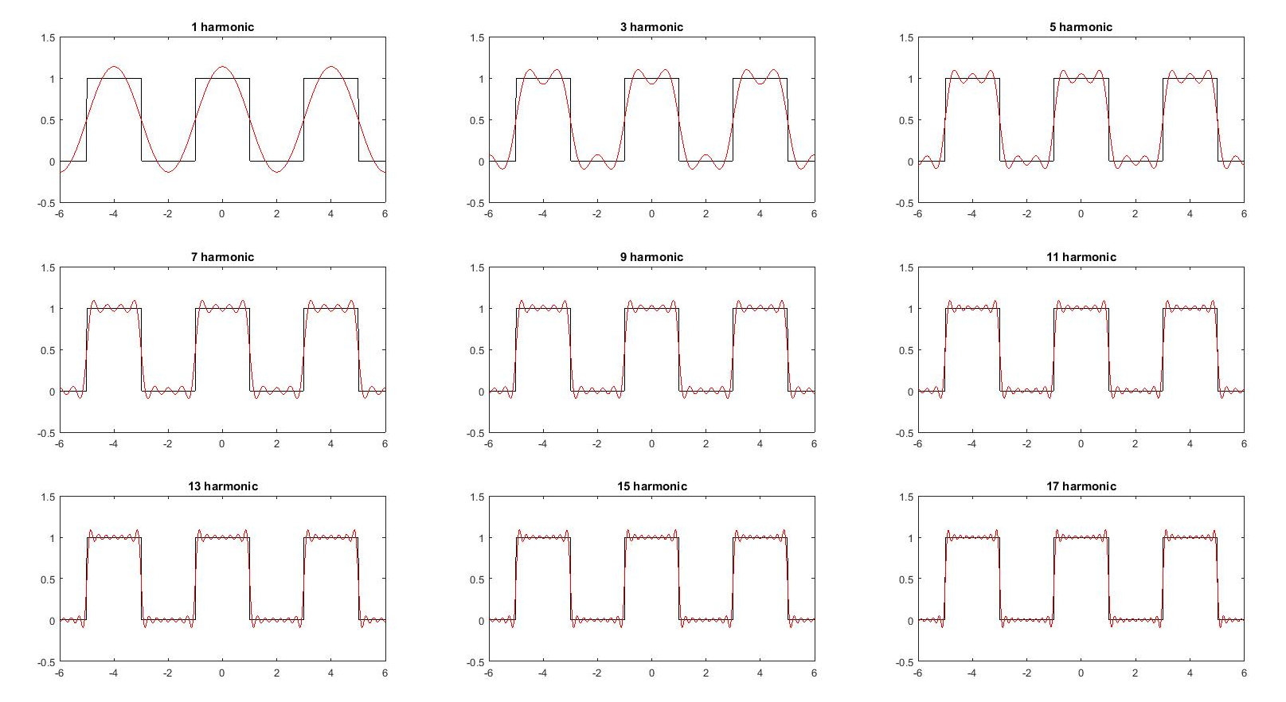

Slide 16
Propagation Modes

Slide 17
Propagation Modes
Transmission lines may be classified into two basic types:
Transverse electromagnetic (TEM) transmission lines
Higher-order transmission lines

Slide 18
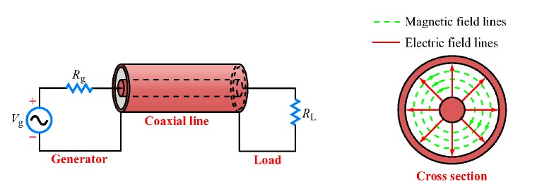
Propagation Modes
Transverse electromagnetic (TEM) transmission lines:
Wave propagation on TEM TLs are defined by electric and magnetic fields which are entirely transverse to the direction of propagation.
Coaxial line example: the electric field is in the radial direction from signal line to ground. The magnetic field circles the inner conductor.
Common features of TEM TLs is that have two parallel conducting surfaces; thus
the used circuit representation.
Only TEM TLs will be addressed in this course.

Slide 19
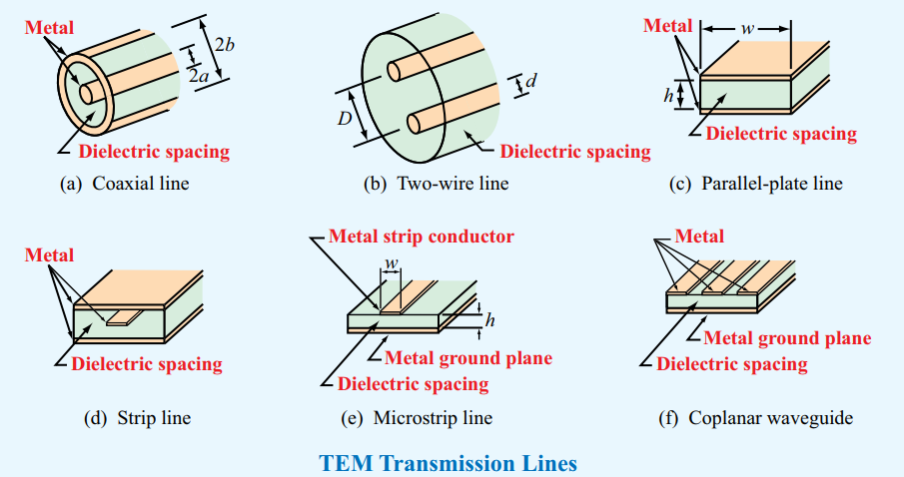
Propagation Modes
Transverse electromagnetic (TEM) transmission lines:
Waves propagating along these lines are characterized by electric and magnetic fields that are entirely transverse to the direction of propagation. Such an orthogonal configuration is called a TEM mode.

Slide 20
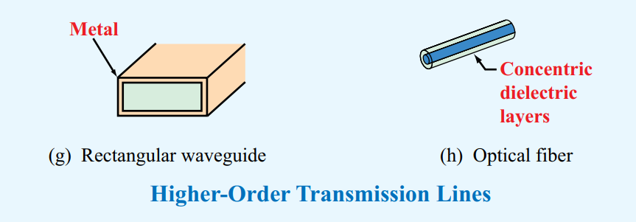
Propagation Modes
Higher-order transmission lines:
Waves propagating along these lines have at least one significant field component in the direction of propagation. Hollow conducting waveguides, dielectric rods, and optical fibers belong to this class of lines.
Note: Only TEM-mode transmission lines are treated in this chapter. This is because they are more commonly used in practice.

Slide 21
Lumped-Element Model

Slide 22
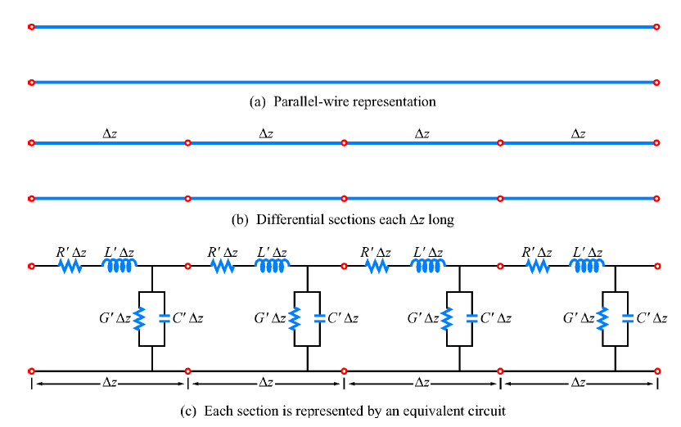
Lumped-Element Model
When we draw a schematic of an electronic circuit, we use specific symbols to represent resistors, capacitors, inductors, diodes, and the like. In each case, the symbol represents the functionality of the device, rather than its shape, size, or other attributes. We shall do the same for transmission lines.

Slide 23
Lumped-Element Model
(a)
(b)
(c)
Regardless of its cross-sectional shape, a TEM transmission line is represented by the parallel-wire configuration shown in (a).
Figure(a) may represent a coaxial line, a two-wire line, or any other TEM line.

Slide 24
Lumped-Element Model
(a)
(b)
(c)
Regardless of its cross-sectional shape, a TEM transmission line is represented by the parallel-wire configuration shown in (a).
To obtain equations relating voltages and currents, the line is subdivided into small differential sections (b), each of which is then represented by an equivalent circuit or unit cell (c).

Slide 25
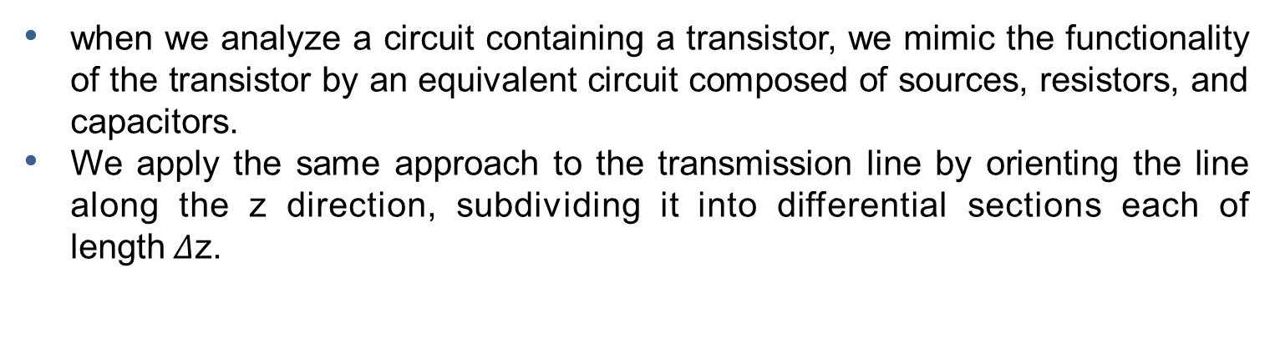
Lumped-Element Model
(a)
(b)
(c)
when we analyze a circuit containing a transistor, we mimic the functionality of the transistor by an equivalent circuit composed of sources, resistors, and capacitors.
We apply the same approach to the transmission line by orienting the line along the z direction, subdividing it into differential sections each of length$Δ$z.

Slide 26
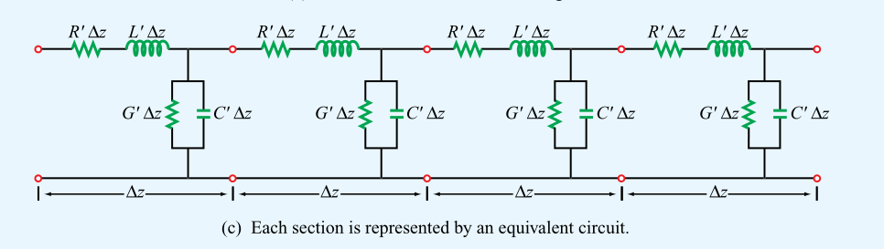
Lumped-Element Model
Representing each section by an equivalent circuit, as illustrated in Figure(c)
This representation, often called the lumped-element circuit model, consists of four basic elements, with values that henceforth will be called the transmission line parameters R’ , L’, G’, C' .
Whereas the four line parameters are characterized by different formulas for different types of transmission lines, the equivalent model represented by Figure(c) is equally applicable to all TEM transmission lines.

Slide 27
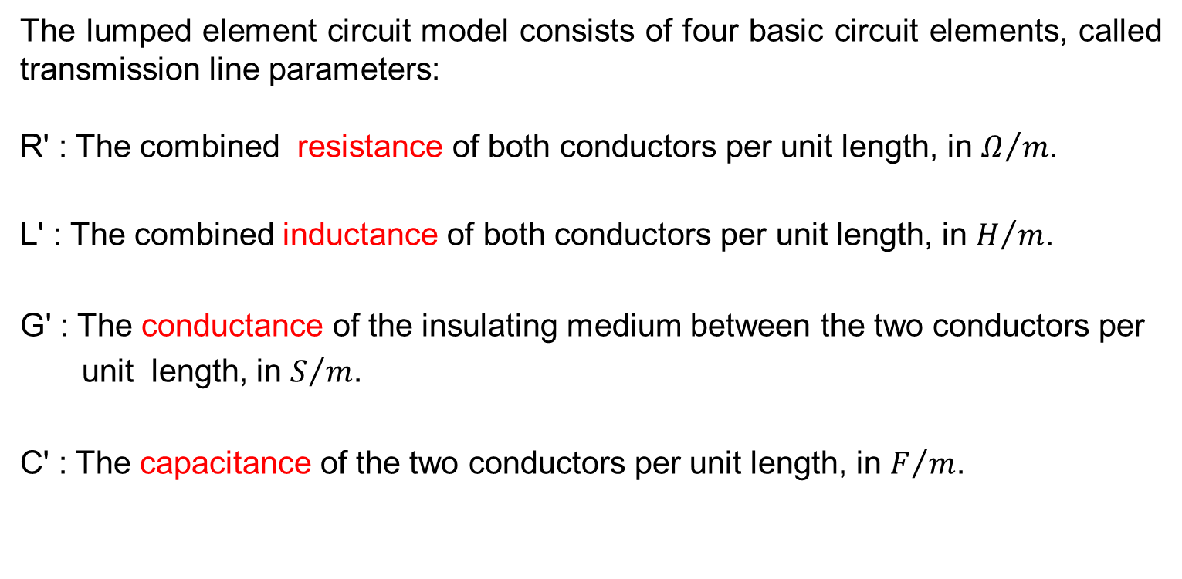
Lumped-Element Model
The lumped element circuit model consists of four basic circuit elements, called transmission line parameters:
R' : The combined resistance of both conductors per unit length, in $Ω/m$.
L' : The combined inductance of both conductors per unit length, in $H/m$.
G' : The conductance of the insulating medium between the two conductors per
unit length, in $S/m$.
C' : The capacitance of the two conductors per unit length, in $F/m$.
The prime superscript is used as a reminder that the line parameters are differential quantities whose units are per unit length.

Slide 28
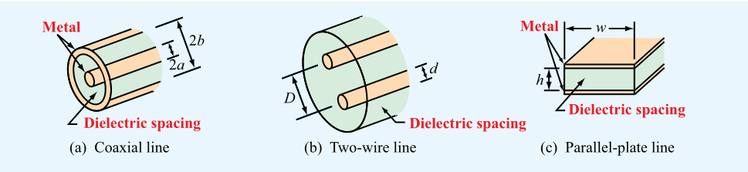
Lumped-Element Model
Expressions for the line parameters R’, L’, G’, and C’ are given in Table for the three types of TEM transmission lines diagrammed in parts (a) through (c).

Slide 29
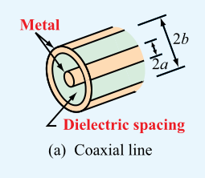


Lumped-Element Model
For each of these lines, the expressions are functions of two sets of parameters: (1) geometric parameters defining the cross-sectional dimensions of the given line and (2) the electromagnetic constitutive parameters of the conducting and insulating materials. The pertinent geometric parameters are:
(a) Coaxial line
$a=$ outer radius of inner conductor, m
$b=$ inner radius of outer conductor, m

Slide 30
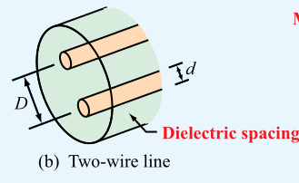
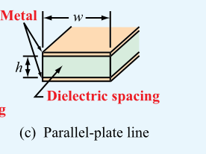




Lumped-Element Model
(b) Two-wire line
$d=$diameter of each wire, m
$D=$ spacing between wires’centers, m
(c) Parallel-plate line
$ω=$ width of each plate, m
$h$ $=$ thickness of insulation between plates, m

Slide 31
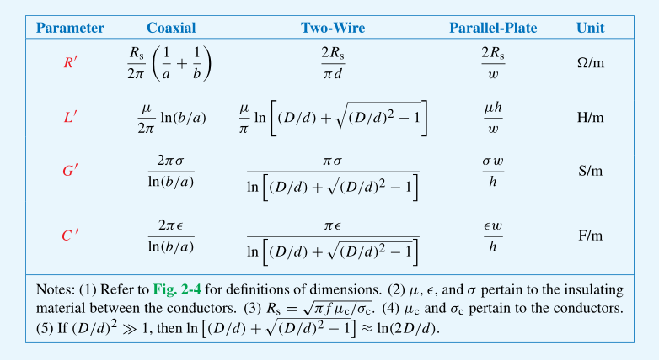
Lumped-Element Model
Transmission-line parameters $R^{′}$, $L^{′}$, $G^{′}$, and $C^{′}$ for three types of lines.

Slide 32
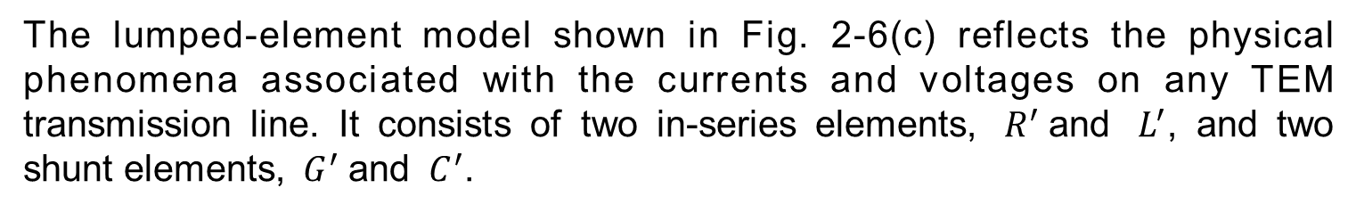
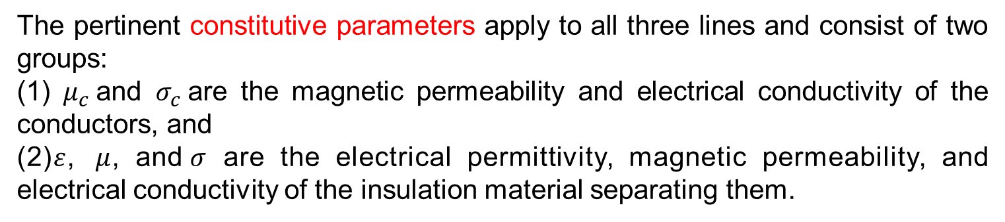
Lumped-Element Model
The pertinent constitutive parameters apply to all three lines and consist of two groups:
(1) $μ_{c}$and $σ_{c}$are the magnetic permeability and electrical conductivity of the conductors, and
(2)$ε$, $μ$, and$σ$ are the electrical permittivity, magnetic permeability, and electrical conductivity of the insulation material separating them.
The lumped-element model shown in Fig. 2-6(c) reflects the physical phenomena associated with the currents and voltages on any TEM transmission line. It consists of two in-series elements, ${ R}^{′}$and ${ L}^{′}$, and two shunt elements, ${ G}^{′}$and ${ C}^{′}$.

Slide 33
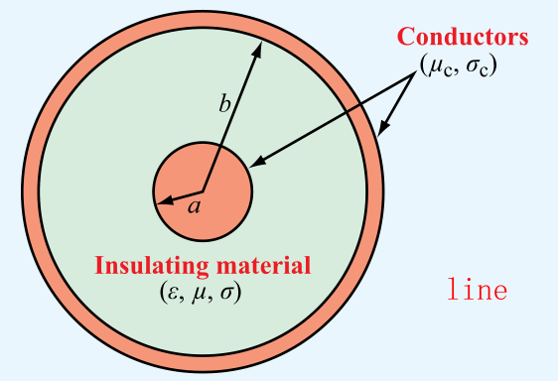
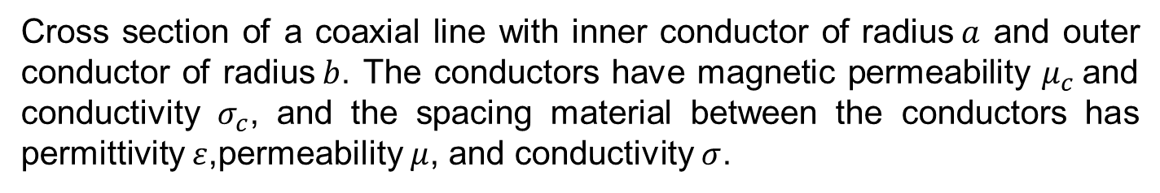
Lumped-Element Model
To explain the lumped-element model, consider a small section of a coaxial line:
Cross section of a coaxial line with inner conductor of radius$a$ and outer conductor of radius$b$. The conductors have magnetic permeability $μ_{c}$and conductivity $σ_{c}$, and the spacing material between the conductors has permittivity $ε$,permeability $μ$, and conductivity $σ$.

Slide 34
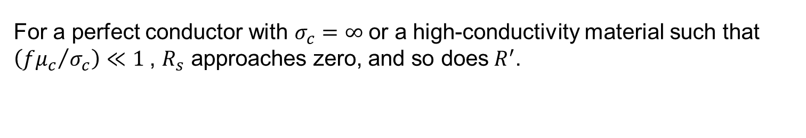
Lumped-Element Model
When a voltage source is connected across the terminals connected to the two conductors at the sending end of the line, currents flow through the conductors, primarily along the outer surface of the inner conductor and the inner surface of the outer conductor.
The coaxial line resistance $R^{′}$accounts for the combined resistance per unit length of the inner and outer conductors:
(coax line)
where,
For a perfect conductor with $σ_{c}=∞$or a high-conductivity material such that $\left({fμ_{c}}/{σ_{c}}\right)≪1$, $R_{s}$ approaches zero, and so does${ R}^{′}$.

Slide 35
Lumped-Element Model
Line inductance $L^{′}$, which accounts for the joint inductance of both conductors per unit length of a coaxial line is :
Line conductance $G^{′}$, accounts for current flow between the outer and inner conductors, per unit length is :
If the material separating the inner and outer conductors is a perfect dielectric with$σ$=0, then $G^{′}$= 0.
Capacitance is defined as the ratio of the charge to the voltage difference. For the coaxial line, the capacitance per unit length is:

Slide 36
Lumped-Element Model
All TEM transmission lines satisfy:
(all TEM lines)
(all TEM lines)

Slide 37
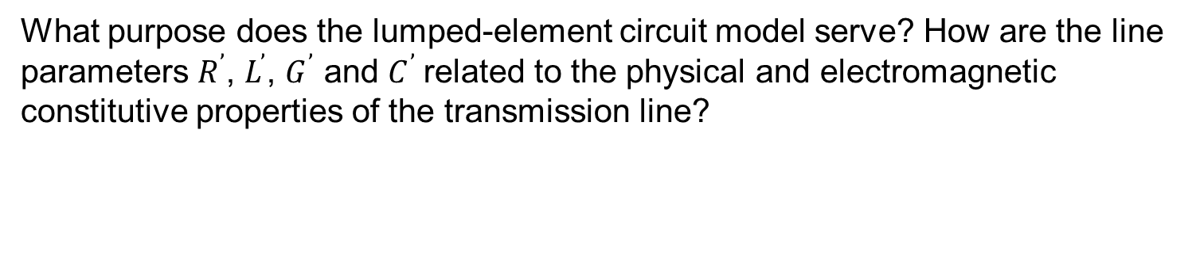
Exercise
Concept Question 2-1:
What is a transmission line? When should transmission-line effects be considered, and when may they be ignored?
Concept Question 2-2:
What is the difference between dispersive and nondispersive transmission lines? What is the practical significance of dispersion?
Concept Question 2-3:
What constitutes a TEM transmission line?
Concept Question 2-4:
What purpose does the lumped-element circuit model serve? How are the line parameters $R^{’}$, $L^{’}$, $G^{’}$ and $C^{’}$related to the physical and electromagnetic constitutive properties of the transmission line?

Slide 38
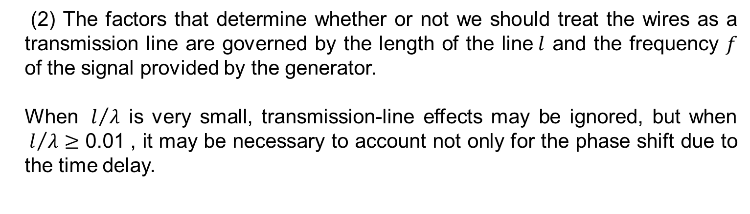
Exercise
Concept Question 2-1:
What is a transmission line? When should transmission-line effects be considered, and when may they be ignored?
Answer:
(2) The factors that determine whether or not we should treat the wires as a transmission line are governed by the length of the line$l$ and the frequency $f$ of the signal provided by the generator.
When ${ l}/λ$ is very small, transmission-line effects may be ignored, but when ${ l}/λ≥\text{0.01}$, it may be necessary to account not only for the phase shift due to the time delay.

Slide 39
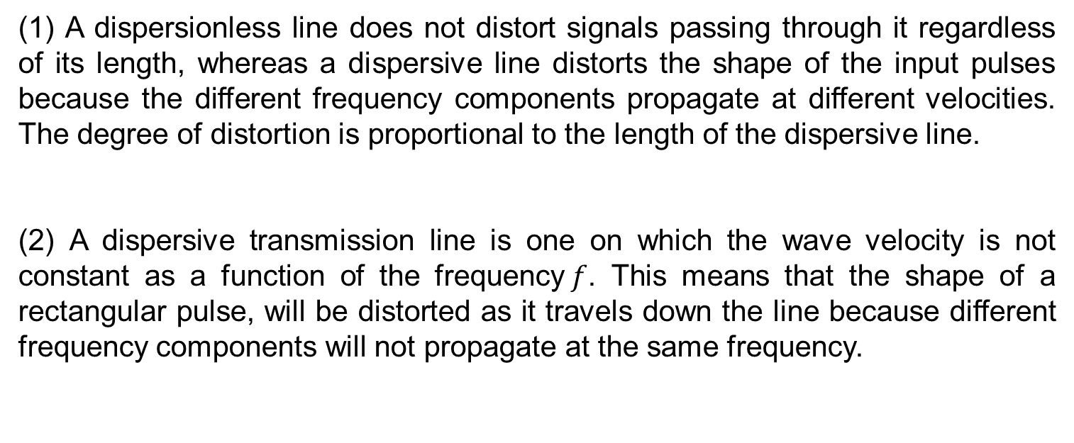
Exercise
Concept Question 2-2:
What is the difference between dispersive and nondispersive transmission lines? What is the practical significance of dispersion?
Answer:
(1) A dispersionless line does not distort signals passing through it regardless of its length, whereas a dispersive line distorts the shape of the input pulses because the different frequency components propagate at different velocities. The degree of distortion is proportional to the length of the dispersive line.
(2) A dispersive transmission line is one on which the wave velocity is not constant as a function of the frequency$f$. This means that the shape of a rectangular pulse, will be distorted as it travels down the line because different frequency components will not propagate at the same frequency.

Slide 40
Exercise
Concept Question 2-3:
What constitutes a TEM transmission line?
Answer:
Waves propagating along these lines are characterized by electric and magnetic fields that are entirely transverse to the direction of propagation. Such an orthogonal configuration is called a TEM mode. A common feature among TEM lines is that they consist of two parallel conducting surfaces.

Slide 41
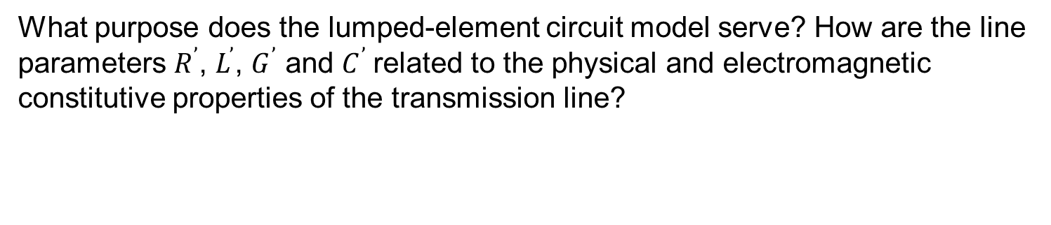
Exercise
Concept Question 2-4:
What purpose does the lumped-element circuit model serve? How are the line parameters $R^{’}$, $L^{’}$, $G^{’}$ and $C^{’}$related to the physical and electromagnetic constitutive properties of the transmission line?
Answer:
The lumped-element model shown in Fig. 2-6(c) reflects the physical phenomena associated with the currents and voltages on any TEM transmission line.

Slide 42
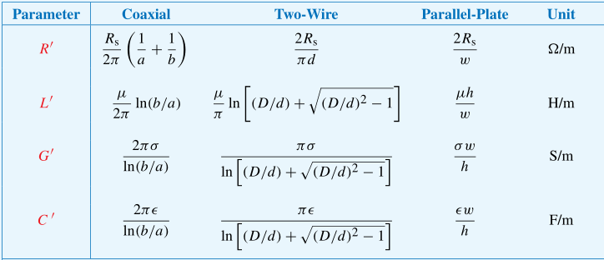
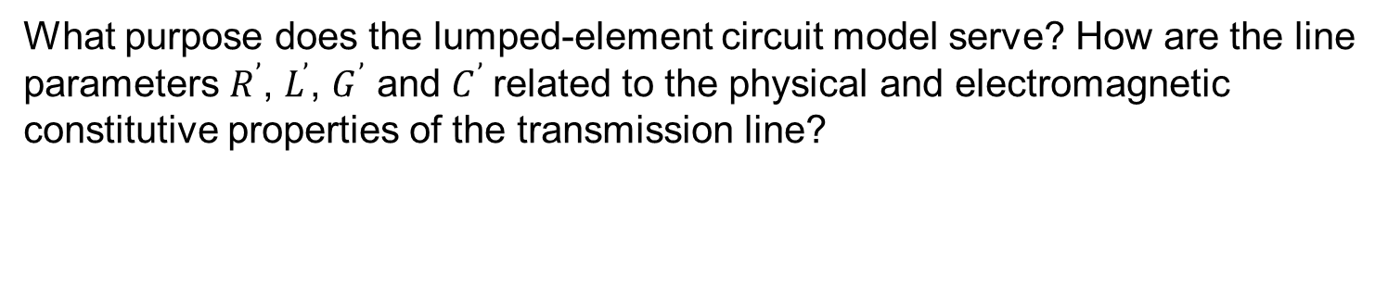
Exercise
Concept Question 2-4:
What purpose does the lumped-element circuit model serve? How are the line parameters $R^{’}$, $L^{’}$, $G^{’}$ and $C^{’}$related to the physical and electromagnetic constitutive properties of the transmission line?
Answer:
(2) Expressions for the line parameters $R^{’}$, $L^{’}$, $G^{’}$, and $C^{’}$are given in Table.
For each of these lines, the expressions are functions of two sets of parameters: (1) geometric parameters defining the cross-sectional dimensions of the given line and (2) the electromagnetic constitutive parameters of the conducting and insulating materials.

Slide 43
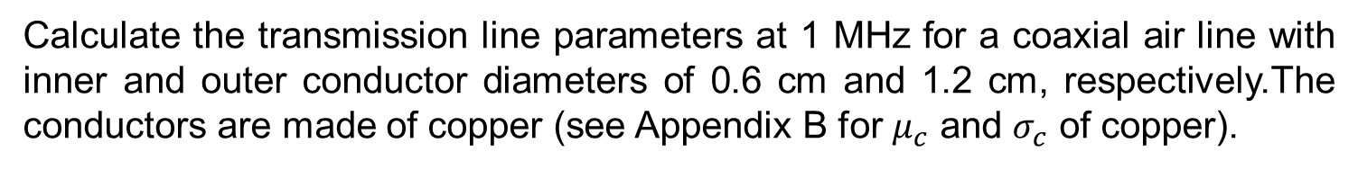
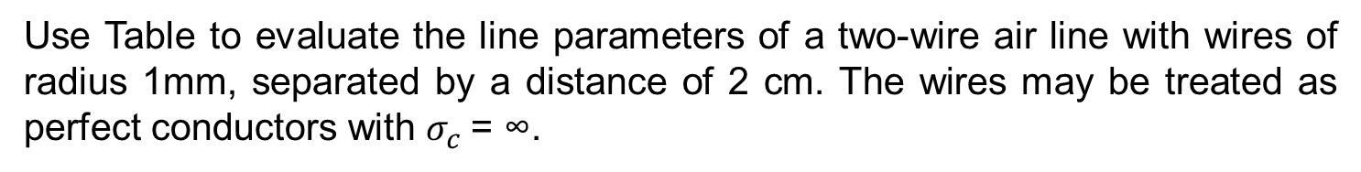
Exercise 2-1
Use Table to evaluate the line parameters of a two-wire air line with wires of radius 1mm, separated by a distance of 2 cm. The wires may be treated as perfect conductors with $σ_{c}$= ∞.
Exercise 2-2
Calculate the transmission line parameters at 1 MHz for a coaxial air line with inner and outer conductor diameters of 0.6 cm and 1.2 cm, respectively.The conductors are made of copper (see Appendix B for $μ_{c}$ and $σ_{c}$ of copper).

Slide 44
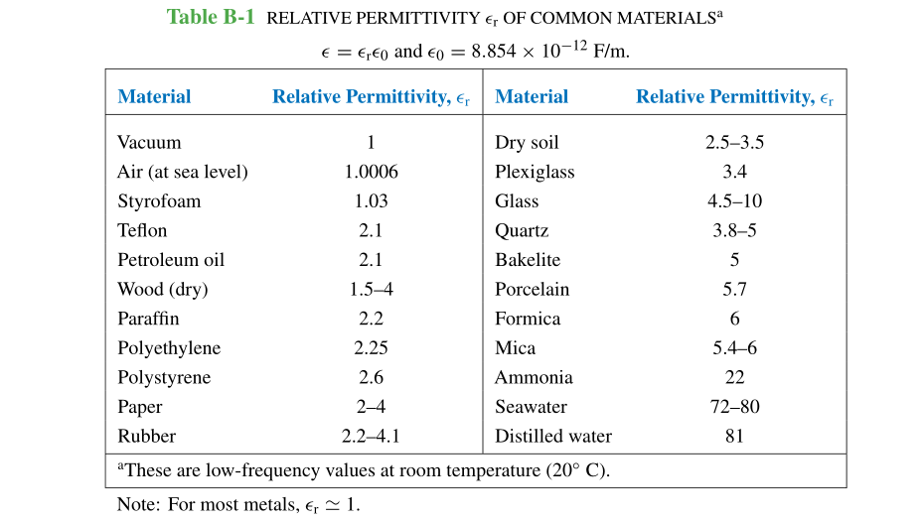

Slide 45
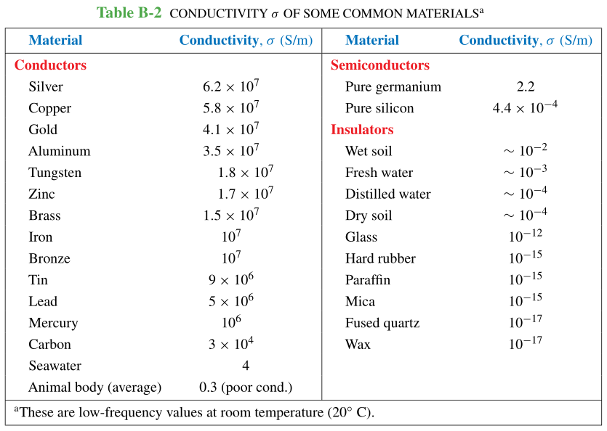

Slide 46
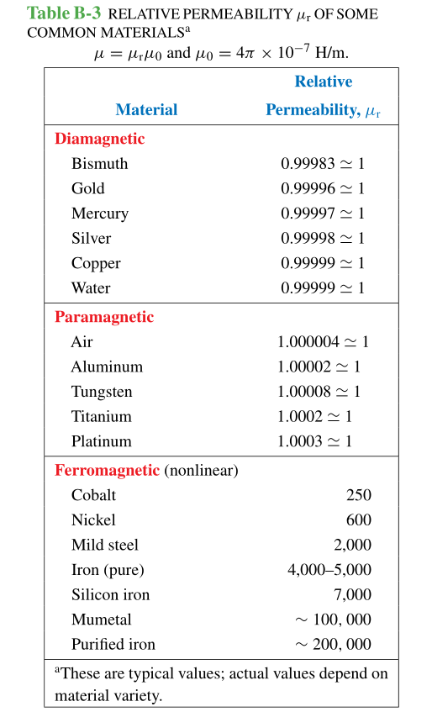

Slide 47
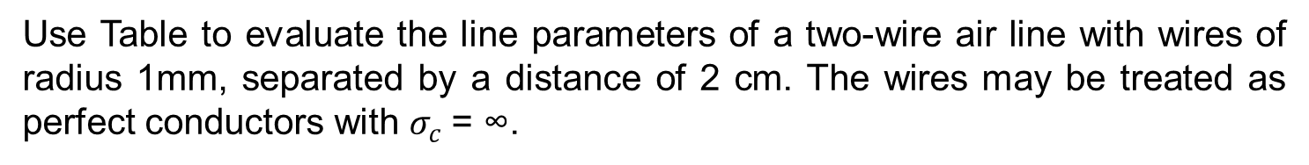
Exercise
Exercise 2-1
Use Table to evaluate the line parameters of a two-wire air line with wires of radius 1mm, separated by a distance of 2 cm. The wires may be treated as perfect conductors with $σ_{c}$= ∞.
Answer:
From the table:

Slide 48
Exercise
From the above table:

Slide 49
Exercise
The following quantities are given:

Slide 50
Exercise
Hence,

Slide 51
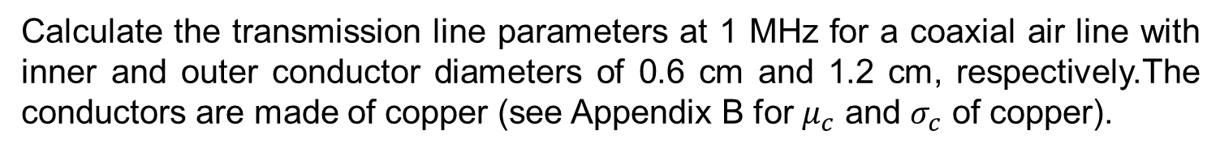
Exercise
Exercise 2-2
Calculate the transmission line parameters at 1 MHz for a coaxial air line with inner and outer conductor diameters of 0.6 cm and 1.2 cm, respectively.The conductors are made of copper (see Appendix B for $μ_{c}$ and $σ_{c}$ of copper).
Answer:
From the table:

Slide 52
Exercise
From the above table:

Slide 53
Exercise
From the above table:

Slide 54
Exercise
The following quantities are given:

Slide 55
Exercise
Hence,

Slide 56
Lecture 3 Transmission-Line Equations

Slide 57
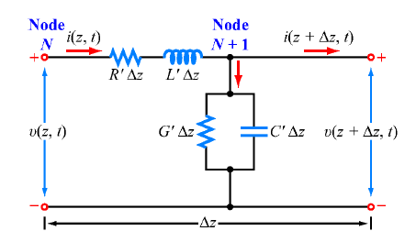
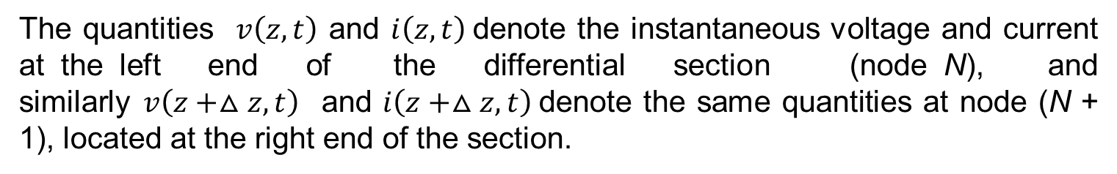
Transmission-Line Equations
A transmission line usually connects a source on one end to a load on the other. Before considering the complete circuit, however, we will develop general equations that describe the voltage across and current carried by the transmission line as a function of time t and spatial position z.
The quantities $v\left(z,t\right)$ and $i\left(z,t\right)$denote the instantaneous voltage and current at the left end of the differential section (node N), and similarly$v\left(z+△z,t\right)$ and $i\left(z+△z,t\right)$denote the same quantities at node (N + 1), located at the right end of the section.

Slide 58
Transmission-Line Equations
Application of Kirchhoff’s voltage law accounts for the voltage drop across the series resistance$R′Δz$ and inductance $L^{′}Δz$

Slide 59
Transmission-Line Equations
Upon dividing all terms by$Δz$ and rearranging them, we obtain
In the limit as$Δz$→ 0, we obtain a differential equation:

Slide 60
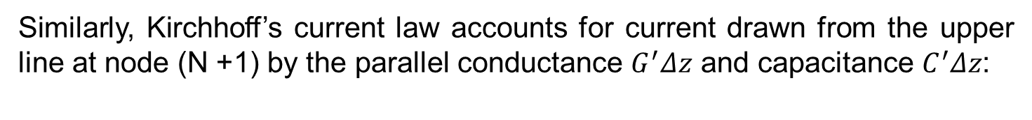
Transmission-Line Equations
Similarly, Kirchhoff’s current law accounts for current drawn from the upper line at node (N +1) by the parallel conductance $G^{′}Δz$ and capacitance $C^{′}Δz$:
Upon dividing all terms by $Δz$ and taking the limit$Δz$→ 0, becomes a second-order differential equation:

Slide 61
Transmission-Line Equations
The first-order differential equations are the time-domain forms of the transmission-line equations, known as the telegrapher’s equations.

Slide 62
Transmission-Line Equations
Our primary interest is in sinusoidal steady-state conditions.We make use of the phasor representation with a cosine reference.Thus, we define
where $\tilde{V}\left(z\right)$and $\tilde{I}\left(z\right)$are the phasor counterparts of$v\left(z,t\right)$ and $I\left(z,t\right)$ respectively.

Slide 63





Transmission-Line Equations
Upon substituting
$v\left(z,t\right)=ℜe\left[\tilde{V}\left(z\right)e^{jωt}\right]$
$i\left(z,t\right)=ℜe\left[\tilde{I}\left(z\right)e^{jωt}\right]$
into
$$−\frac{∂v\left(z,t\right)}{∂z}=R^{′}i\left(z,t\right)+L^{′}\frac{∂i\left(z,t\right)}{∂t}$$
$$−\frac{∂i\left(z,t\right)}{∂z}=G^{′}v\left(z,t\right)+C^{′}\frac{∂v\left(z,t\right)}{∂t}$$
utilizing the property given by $\frac{di}{dt}=ℜe\left[jω\tilde{I}e^{jwt}\right]$that ∂/∂t in time domain is equivalent to multiplication by$jω$in the phasor domain, we obtain :
(telegrapher’s equations in phasor form)

